Slide 1
A Good Mimic
A Tabletop Simulation

Slide 2
You arrive on Wednesday evening for a softball game on Friday evening at 4 p.m.
During the bus ride to the hotel, you find yourself speaking to Keola, the starting pitcher.
Keola is famous on the softball team. Keola is a leader in school and very political. You heard that Keola kneels during the national anthem and plans to do so at the game in Texas.

Slide 3
What is your understanding of what “political” speech is allowed for college or NCAA athletes?
Where can we find these rules?
Should athletes speak out on their personal beliefs, political views, or values?
For whom do you (the HCP) advocate: the school, the NCAA, or the athlete?
Notes:
7 minutes

Slide 4
You ask Keola about kneeling and she responds,
“I am glad you asked. It is an enormous topic. You basically asked me how being Black Polynesian in America affects my life. Many things that I experience are because of my skin color, and that is why I kneel. Since its beginnings, America has excluded people of color in many ways, and I kneel because I believe the facts show there is one America for people of color and one for those who are not. Kneeling represents those two Americas.”
She then adds,
“The NCAA has problems too. The NCAA controls so many opportunities in our lives.”

Slide 5
What do you think about her perspective? Can you relate or not?
What is your understanding of why some athletes kneel during the national anthem, or why would you choose to kneel or not kneel?
What is the rule for your institution and kneeling?
What do you know about how the NCAA operates or how it is involved with the lives of athletes and how much it controls?
Notes:
5 minutes

Slide 6
The Next Morning: Thursday
10:00 a.m.—Day before game, practice day. It is warm, 70 °F (21 °C), early spring, 2,000 feet above sea level, and humidity is 48 percent.

Slide 7
The head AT comes to you and says,
“Keola is complaining of ankle pain. Go check it out. I heard that Keola is upset because of the recent politics and may not want to play. I think she is going to kneel during the national anthem. This may not go well here. So, just let me know if the ankle pain is real or if you think it is a political move. Not playing in the game could be some sort of protest.”

Slide 8
Tell me about the request from the head AT and tell me what you think you should do?
How does this request make you feel?
What is your job?
Notes:
5 minutes

Slide 9
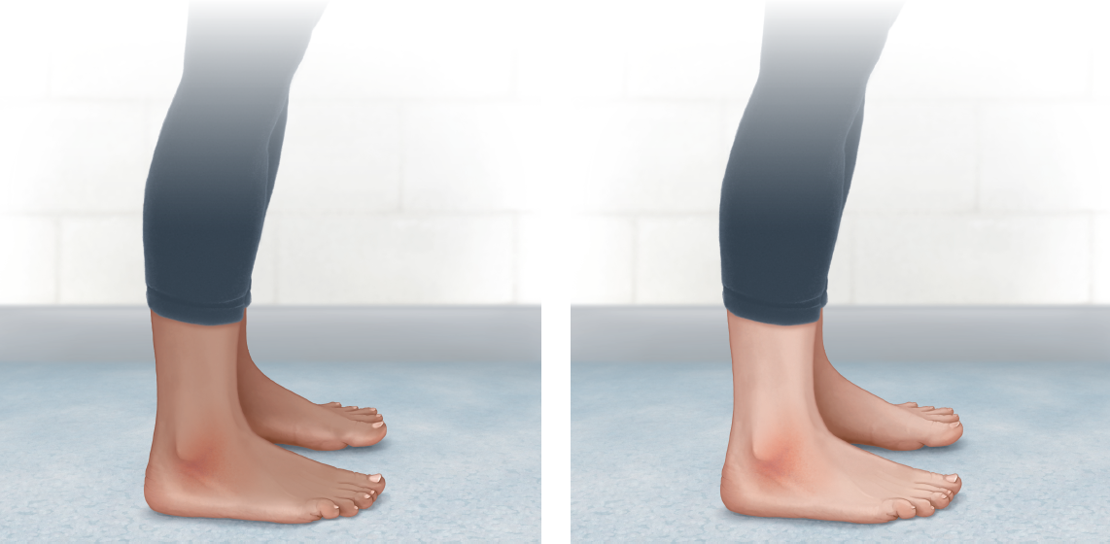
Divide into pairs.
DO NOT START. YOU WILL START AFTER I GO TO THE NEXT SLIDE.
One of you is a PATIENT
Please come get a note card.
Do not provide patient information that is not requested.
One of you is a PROVIDER, you will have up to seven minutes to perform an evaluation.
Notes:
3 minutes
Notecards are a separate file.
Instructor: You will each be given 3 different pictures of the same injury at the same state of development but in 3 different skin tones. Evaluate the person in front of you but the notecards can be used as a reference.
“If you are the patient, please come up and get a notecard and some photos. Please read through the notecard right here and ask me if you have any questions. These photos should be shared with provider and patient.
If you are the provider, please go to a treatment table and wait for the patient.”

Slide 10
If you are the provider, please go to a treatment table and wait for the patient.
I will keep two different pictures of the same injury at the same state of development but with three different skin tones on the screen. Evaluate the person in front of you (your peer) with these pictures in mind. The patient will use the note card for patient information.
If you are the patient, please come up and get a note card. Please read through the note card right here and ask me if you have any questions. Then, go to your partner and treatment table.
Notes:
3 minutes

Slide 11
You have seven minutes for evaluation
Notes:
8 minutes

Slide 12
After you complete the assessment and decide to tape her ankle, Keola hands you some rainbow tape and says, “What do you know about discrimination in athletics? You can tell me while you tape my ankle. It hurts a little, but I want to move it around a bit.”
Notes:
5 minutes

Slide 13
Keola has her opinions on race, gender, and the treatment of athletes in college sports. Do you have any perspectives or opinions on race, gender, or the treatment of athletes in college sports?
Notes:
7 minutes

Slide 14
You have taped her ankle, suggest ibuprofen 600 milligrams, some ice, elevation, and rest.
You have suggested medications to Keola and she has some medication history.
What are Keola’s medications?
What about ibuprofen, good? Problems?
Any other medications that concern you or you have questions about?

Slide 15
It is now 4:00 p.m. on Thursday with practice starting at 5:00 p.m.
Keola returns, “I don’t know what it is, but I don’t think it is just an ankle injury.” The swelling and pain have definitely gotten worse.

Slide 16
Same Pair But Switch Patient: Provider Role
PATIENT (pick up card, any questions)
PROVIDER. (go to treatment table)
Notes:
2 minutes
Notecards are a separate file.
Instructor: You will each be given 3 different pictures of the same injury at the same state of development but in 3 different skin tones. Evaluate the person in front of you but the notecards can be used as a reference.
“If you are the patient, please come up and get a notecard and some photos. Please read through the notecard right here and ask me if you have any questions. These photos should be shared with provider and patient.
If you are the provider, please go to a treatment table and wait for the patient.”

Slide 17
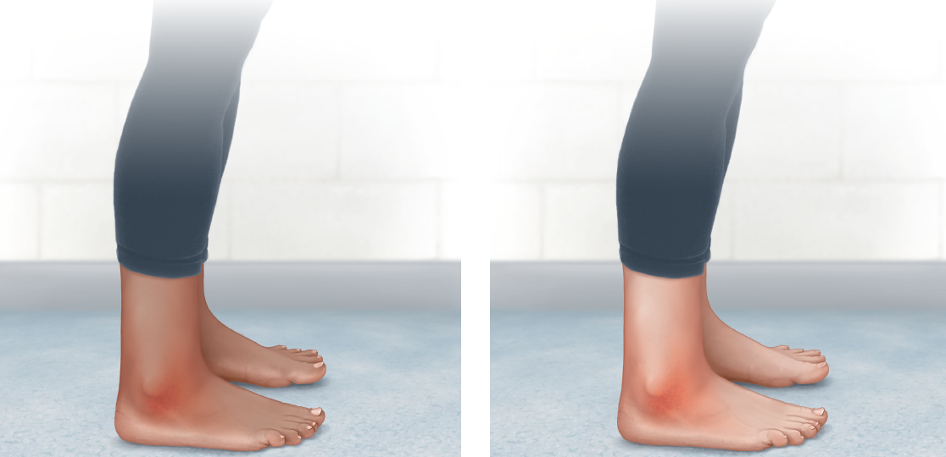
Figure out what is going on and decide if she can practice.
You now notice increased redness around the ankle and notice redness starting in the toes.
You have five minutes
Notes:
5 minutes

Slide 18
Is this a musculoskeletal (MSK) injury? If not, then what?

Slide 19
She reports symptoms of an illness, right?
What if I give new meds like cold and flu medicine or acetaminophen at this point?
Any ideas?
What do we do?
Notes:
3 minutes

Slide 20
Let’s Investigate the Possibilities
Group 1
Osteomyelitis, rheumatoid arthritis, flat foot – Pes planus, flu
Group 2
Gout, bursitis, bacterial skin infection (cellulitis), COVID
Group 3
Ankle edema, Staph, infected joint (septic arthritis), mononucleosis
Group 4
Achilles injury or rupture or tendinitis, stress fracture, psoriatic arthritis, cold

Slide 21
Your group has seven minutes to pick your top differential diagnosis, and it must include: S&S, Presentation, Onset, Quality, Severity, Progression, Tests, History
Group 1
Osteomyelitis, rheumatoid arthritis, flat foot – Pes planus, flu
Group 2
Gout, bursitis, bacterial skin infection (cellulitis), COVID-19
Group 3
Ankle edema, Staph, infected joint (septic arthritis), mononucleosis
Group 4
Achilles injury or rupture or tendinitis, stress fracture, psoriatic arthritis, cold

Slide 22
Listen and Vote On the Clinical Diagnosis
Each group has one minute to present their top pick.
We have two minutes to pick the most likely diagnosis.
What is your vote?
I will write the two (or three) highest vote getters on the board
Notes:
8-10 minutes

Slide 23
Just when you think you know what it is, the athlete calls and says, “I spoke to my mom and dad. I think it’s gout.” “Can you get me some tart cherry juice, ginger, apple cider vinegar, and lemon juice? This has worked in the past for my family when a flare up has occurred, and it means I don’t have to see the doctor.”

Slide 24
Can the group who studied gout present on gout (again)?
Do we agree? Is that a likely diagnosis?
What do you think about this request for alternative therapies?
Knowing it is, or could be gout, what is your next step and will you provide alternative therapies?
Notes:
5 minutes

Slide 25
Whether it is gout or not, you recommend contacting the team physician to get medicine and an additional person to consult.
Keola agrees but reiterates that seeing a doctor for this is not the preference.
Keola asks if you know whether the family’s insurance gets billed before the university's insurance.
And ends with, “What do you think of home remedies? Can you get me that stuff, the cherry juice and such? I mean the medical system was not designed for a person like me.”
In typical Keola fashion, she provides evidence to support her belief about the medical system not being for her by emailing information on gout.

Slide 26
“I will call you after I speak to the doctor.”
You quickly read the email before calling:
The lack of research in African Americans with gout, a racial group with higher disease prevalence and burden of gout than Caucasians (5% vs. 4% in the United States), is concerning [1]. Although gout is not as common as it is in men, the prevalence is 2 percent in US adult women [1], twice that of rheumatoid arthritis at 1 percent [27]. A literature search using the same terms (quality of life, women) found eight publications on gout (none with original data, none relevant) versus 213 publications on rheumatoid arthritis, indicating the lack of recognition of the impact of gout on women.
"The impact of gout on patient's lives: a study of African-American and Caucasian men and women with gout" by Jasvinder A. Singh, published in Arthritis Research & Therapy in 2014.

Slide 27
How important is it to know the participant demographics of the research we are reading? (Was it only done on males, on healthy individuals, young people, or one racial group?)
How important is it to know the perspective of our patients?
While only Keola can describe to us her choices, do some of them make sense based on her experience and knowledge?
What can we do to ensure we are treating Keola with the dignity and respect that all patients deserve?
Notes:
5 minutes

Slide 28
What Are You Going to Say to the Physician?
Notes:
3 minutes

Slide 29
Physician Response
The physician recommends that Keola be seen by a provider. Keola is young for gout, and this would be her first flare-up. However, the physician recommends some medications that are not harmful. “If Keola is unwilling to see a provider, Keola can start with these (colchicine, ibuprofen, acetaminophen, ketoralac), and yes, you can give Keola the other remedies as well. Of course, when you return to campus, I would like to see her.”
Keola agrees to take both the prescribed and home remedy medicine.

Slide 30
What does the pharmacist think about all these things?
With her new medications, her old medications, and home remedies, what are some possible interactions or side effects?
Notes:
5 minutes

Slide 31
Day 2: Next Morning at 7:00 a.m.—Game Day
Keola says, “I feel worse. These medicines do not work.”
Keola now has wrist pain and swelling.
No change or improvement in ankle.
Keola now reports having diarrhea.
Keola now has a headache and her temperature remains.
My dad said, “This is exactly what it feels like and how it worked on me.”
Keola has never been officially diagnosed by a doctor. Keola’s father has been diagnosed.

Slide 32
How do we convince Keola to see another provider?
Why is further testing important?
What testing should Keola get?
Notes:
3 minutes

Slide 33
You convince Keola to get blood work and urinalysis
BLOOD WORK AND URINALYSIS
INFECTION!!! (Cellulitis)
MRI confirmed cellulitis

Slide 34
How do we feel about it not being a lateral ankle sprain, gout, the flu, and that we struggled to help her quickly?
From the provider’s perspective and Keola’s perspective, what were the barriers to efficient and effective health care?
From the provider’s perspective and Keola’s perspective, what were the facilitators to efficient and effective health care?
What can we do in the future to make this better for Keola, us, and everyone involved, or is this just how some things will go?
Notes:
7 minutes

Slide 35
Health Care Power Wheel
Step 1: As part of the preparation activities, you noted aspects of the wheel of power for yourself. Now, as a group, where appropriate, relabel each segment of the power wheel to make it either directly related to health care, or labeled specifically to athletic training. You will have four minutes to do this.
Step 2: Identify two ways that shift power more in Keola’s favor on your health care power wheel. You will have two minutes for this.
Step 3: Share one shift with the class. One minute for each group.

Slide 36
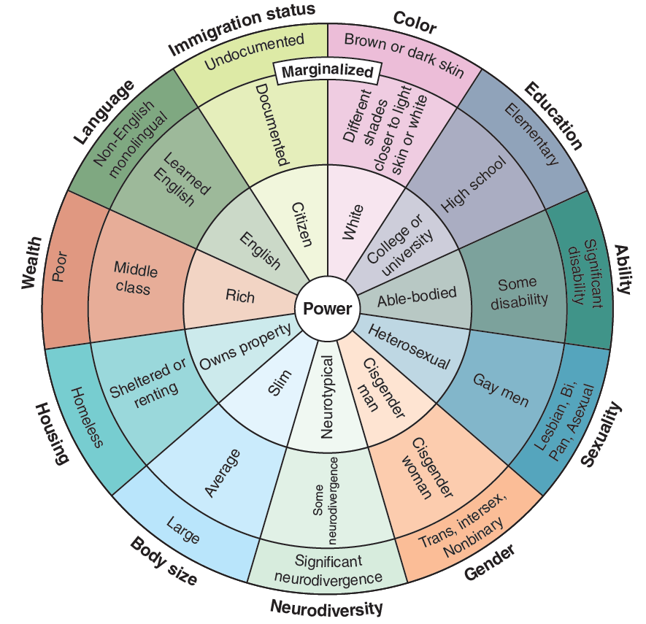
Adapted from ccrweb.ca, © Slyvia Duckworth. Distributed under the terms of the Creative Commons Attribution 4.0 International License (http://creativecommons.org/licenses/by/4.0/).

